Slide 1
Storage for the DBA
Denny Cherry
Manager of Information Systems
mrdenny@mrdenny.com
MVP, MCSA, MCDBA, MCTS, MCITP

Slide 2
Just to be clear …
Any Questions?

Slide 3
Topic Highlights
Storage Arrays
Storage Networks
Virtualizing SQL Servers

Slide 4
Storage Agenda
Storage Terminology
Array Cache Setup
RAID Types
Tiered Storage
Disk Alignment
Spindle Types
Physical Array Diagram
Array Design Differences
Snapshots, Clones
Array Based Replication
Multipath IO Drivers
Thin Luns
Monitoring
Power Up / Power Down

Slide 5
Storage Terminology
LUN = Logical Unit Number
Host = The Server or Servers a LUN is presented to
SAN = Storage Area Network
Fabric = Network which makes up the SAN
Spindle = Physical disks in the Storage Array
Array = Box with the Spindles in it

Slide 6
Storage Terminology
Disk = How the OS sees a LUN when presented
IOps = Physical Operation To Disk
Sequential IO = Reads or writes which are sequential on the spindle
Random IO = Reads or writes which are located at random positions on the spindle

Slide 7
Cache Setup
OLTP databases make poor use of SAN read cache
OLAP databases make good use of SAN read cache
Try reducing read cache and increasing write cache
OLTP databases with high buffer cache hit ratios may be able to have the read cache disabled
There is no one correct setup. Every system is different.

Slide 8
When Cache Gets Full?
Doesn’t flush to disk until low watermark is hit
Force flushes once high watermark is hit
Force flushing completely empties write cache
Force flushing disables write cache until write cache is disabled
If adjustable, set low very low, and high watermark very high (20/90)

Slide 9
Oh crap the power went out!
Most arrays have internal batteries
Write cache is flushed to disk
After flush array powers down
On power-up flushed cached is read and committed to LUNs before LUN is made available
Make sure SQL is down before the array flushes

Slide 10
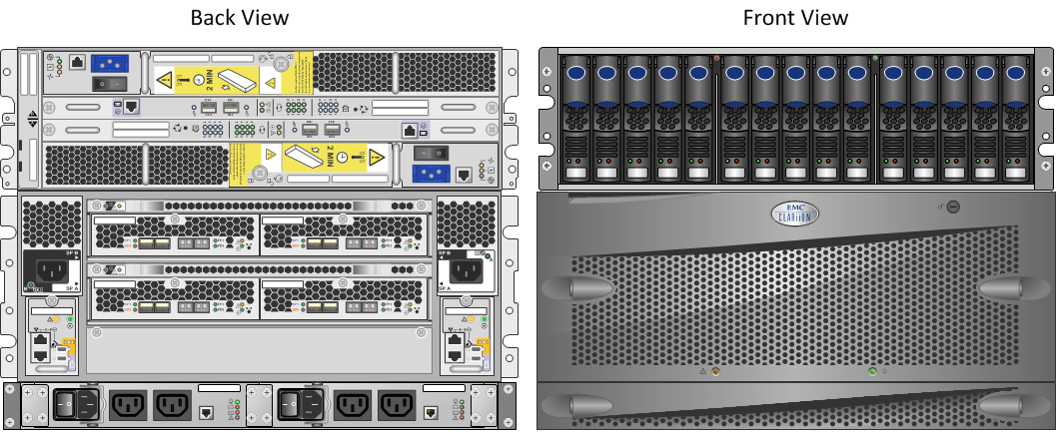
EMC Physical Diagram

Slide 11
Flash Cache
Being introduced by some vendors
Either EFDs or flash card used as secondary cache
High cost
High performance
Some vendors provide redundancy with cache, some don’t.
Some vendors provide for read only, some read write

Slide 12
RAID Types
RAID 0
Straight Stripe
No redundancy
Very fast
Low cost
Any disk failure looses data
Can not survive no disks failures
Requires 2 or more disks

Slide 13
RAID Types
RAID 1
Full Mirror of data
No performance Benefit
High Cost
Requires 2 disks
Can survive 1 disk failure

Slide 14
RAID Types
RAID 0+1
Drives Striped, then Stripes Mirrored
High Cost
High Performance
Requires 2 disks
Requires an even number of disks
Can survive 1 spindle failure
May survive multiple spindle failure

Slide 15
RAID Types
RAID 10 (aka 1+0)
Drives Mirrored, then Mirrors Striped
High Cost
High Performance
Requires 2 disks
Requires an even number of disks
Can survive 1 spindle failure
May survive multiple spindle failure

Slide 16
RAID Types
RAID 5
Stripe with single parity drive
Low cost
Good performance
Write penalty
Can survive a single drive failure
Requires at least 3 disks

Slide 17
RAID Types
RAID 6
Stripe with two parity drives
Slightly higher cost per gig than RAID 5, good performance
Same write penalty as RAID 5
Can survive 2 disk failures
Requires at least 4 disks

Slide 18
What’s the correct choice?
Logs, TempDB – RAID 1, 10, 0+1
System Databases – RAID 5, 6
Backups – RAID 5, 6
User Data – RAID 5
Indexes – RAID 5

Slide 19
When to switch RAID types
From 5 to 10 (or 0+1)?
Over 10% data change (30% on EMC storage)
High writes
Cache is force flushing
From 5 to 6?
Disks fail often

Slide 20
Tiered Storage
Time is Money
http://www.flickr.com/photos/21560098@N06/3832712784/

Slide 21
Tiered Storage
Tier 0
Enterprise Flash Disks low capacity drives
Very high cost
Very high speed storage
Great for Databases

Slide 22
Tiered Storage
Tier 1
15k RPM Fibre Channel low capacity drives
High cost, high speed storage
Great for Databases, Exchange, Virtual Machines

Slide 23
Tiered Storage
Tier 2
10k RPM Fibre Channel medium capacity drives
Medium cost, medium speed storage
Great for File Servers, Database Archives

Slide 24
Tiered Storage
Tier 3
7.2/5.4k RPM SATA/SAS high capacity drives
Low cost, low speed storage
Great for Backups, Archives

Slide 25
Disk Alignment
Can improve SQL disk performance up to 100%
(64 1k blocks/64k IO)=100% of IO is impacted
Must be done before data is put on the disk
Windows 2000 - Diskpar
Windows 2003 - Diskpart
Windows 2008 - Automatic

Slide 26
Disk Alignment

Slide 27
Bus Speeds
Front end ports – 2-8 Gigs
Ports the clients use to connect to the storage array
Back end ports – 1-20 Gigs
Ports the controller uses to talk to other components within the array

Slide 28
Spindle Types
Enterprise Flash Disks (EFDs)
Newest Technology
4 Gig Buss Speed
Up to 30k IO per spindle
Fiber Channel (FC)
2-4 Gig bus speeds
10k-15k RPM
Up to ~300 IO per spindle

Slide 29
Spindle Types
SCSI
Older Technology
1-2 Gig Bus Speed
Up to 200 IO per spindle
Up to 10k RPM
SATA
Newer Technology
1-4 Gig buss speed
Up to 200 IO per spindle
7200 RPM

Slide 30
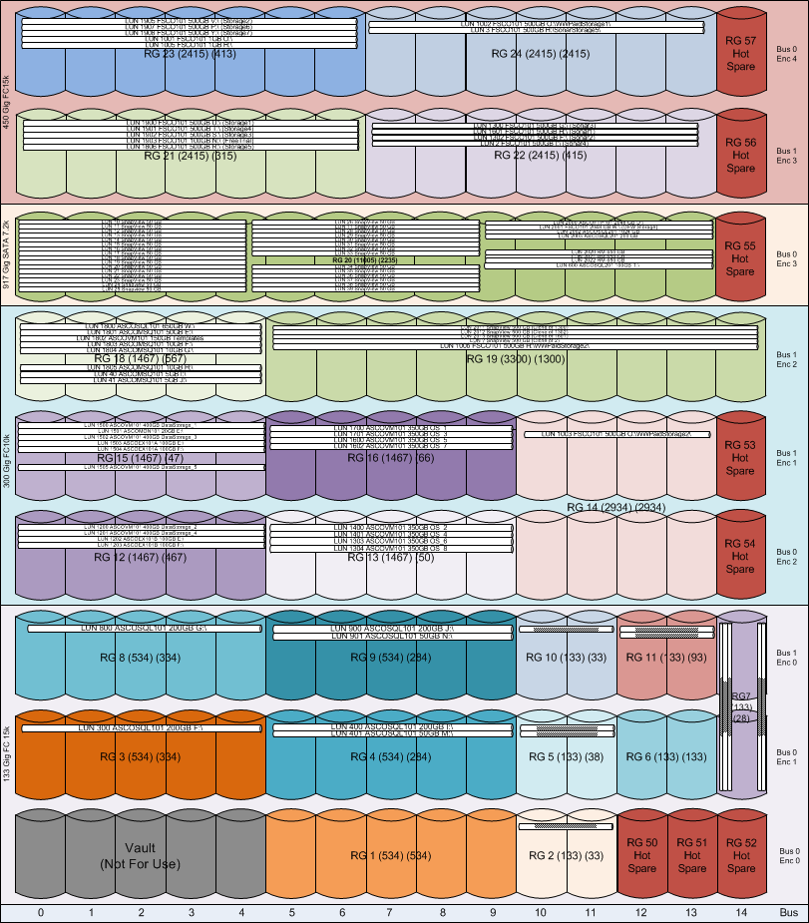
Array Diagram

Slide 31
Different Storage Array Design Techniques
Shared Everything (RAID 10)
Shared Everything (RAID 6)
Shared Some with Admin Control
No RAID arrays

Slide 32
Shared Everything (RAID 10)
3PAR
Each pair of disks is a RAID 1 array
Use Lots of Disks
Data on Disks is a chunk
Create LUNs as (disks*chunk size)
One disk slows down, everything slows down
No Parity Calculations

Slide 33
Shared Some with RAID 6
NetApp
Each shelf is a RAID 6 Array
Each write has two parity calculations
One LUN slows down, everything on the shelf slows down.
Easy to manage

Slide 34
Shared Some Array
EMC, Hitachi, Some IBM Units
High Management Overhead
Total Control of LUN placement
LUN can span RAID groups

Slide 35
No RAID Storage Arrays
IBM XIV
Disk shelves are either IO modules or disk modules
Data is placed on one IO module and one disk module
LUNs are created in 1 Meg chunks on as many disks are needed to create the LUN.
Can survive multiple disk failures
Can survive multiple shelf failures
If the right two disks fail, a LUN can become corrupt

Slide 36
No RAID Storage Arrays
How the data is written

Slide 37
Snapshots
Similar to SQL Server Snapshots
A consistent point in time snapshot on a LUN
Can be mounted to other servers in read or read/write mode
Requires that host disks be flushed before spapshot can be taken

Slide 38
Clones
Exact duplicate of source LUN
Typically created on different physical disks

Slide 39
Copy on First Write
Used by most arrays for snapshots
Used by VMware for snapshots
First time block is written to, old block is copied to snapshot location

Slide 40
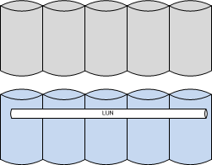
Copy on First Write
Snapshot is Taken
Snapshot Space
Data Raid Groups

Slide 41
Without Consistency you’ll have egg all over your face.

Slide 42
Consistency is Key
When taking a snapshot of LUNs hosting databases all LUNs must be consistent with each other or database will be suspect.
Requires host flushes all writes to disk, and pauses all writes while snapshot is taken.

Slide 43
Array based replication
Techniques vary depending on array vendor
Most arrays can only replicate to same brand or series
EMC to EMC
IBM to IBM
NetApp to NetApp
Can be done with synchronous or asynchronous
Synchronous shouldn’t has a ~100 km limit

Slide 44
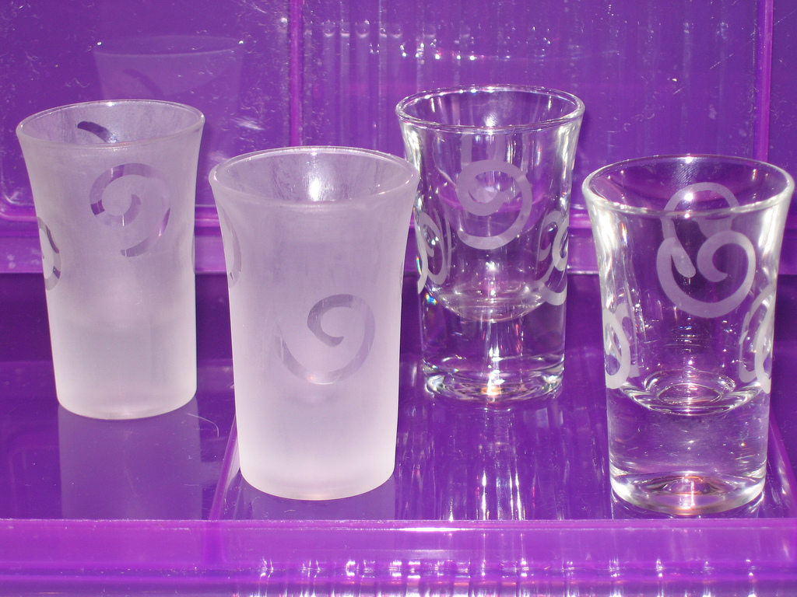
MPIO Drivers
Without MPIO Drivers
http://www.flickr.com/photos/ellipse/67038205/

Slide 45
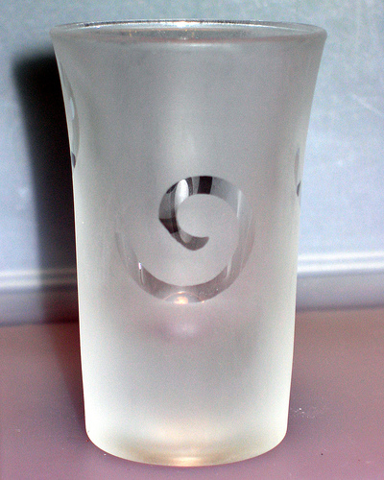
MPIO Drivers
With MPIO Drivers
http://www.flickr.com/photos/ellipse/67038430/

Slide 46
MPIO Drivers
Windows 2003+ includes a native MPIO driver
Native driver supports only 1 active path
Some 3rd party MPIO drivers support multiple active paths
Native driver is free, 3rd party drivers not so much

Slide 47
Thin Luns
Allows for over committing of storage
Allocates storage as needed when needed
Allows business to request huge amounts of storage when small amounts of storage are actually needed
Pretty much pointless for databases

Slide 48
Monitoring
Storage arrays require monitoring
Some monitoring packages are add-on modules
Host based monitoring (perfmon) isn’t giving you the whole story
Monitor RAID Group, LUN, Disks
Know which monitors are averages, which are maximums

Slide 49
Power Up / Power Down
Power Up Sequence
Power Down Sequence
Switches
Storage Array Disks
Storage Array Controller
Servers
Servers
Storage Array Controller
Storage Array Disks
Switches

Slide 50
Contrary to popular belief…
Not all arrays do everything well
Storage Arrays require maintenance
SANs make good NASs but NASs don’t make good SANs
Writing fast <> reading fast

Slide 51
Storage Network Agenda
When to use iSCSI or Fibre Channel
What needs to be redundant?
Path Count
What can be Active/Active and what can’t?
When should the switches be connected together?
Calculating network latency

Slide 52
iSCSI VS Fibre Channel
Its about choice. The same choice doesn’t work for every situation.
http://www.flickr.com/photos/randysonofrobert/385847732/

Slide 53
What needs to be Redundant?
HBAs / iSCSI NICs
Fiber Channel Switches / Network Switches
Storage Controllers
Front End Ports Array Ports
Back End Loops

Slide 54
Redundant Fiber Channel Network

Slide 55
Redundant iSCSI Network

Slide 56
Redundant iSCSI Network w/ Virtualization

Slide 57
Path Count
Each HBA has a path to each front end port on the same switch
Each iSCSI has a path to each front end port to which connectivity is granted.

Slide 58
Fiber Channel Paths

Slide 59
iSCSI Paths

Slide 60
What can be Active/Active?
Yes
No
HBAs
Switches
Array Storage Processors
Single LUN Accessed through multiple switches (sometimes)
Single LUN Accessed through multiple HBAs (sometimes)
Single LUN on multiple Storage Processors
Multiple Servers Accessing the same LUN

Slide 61
Why Active/Active?
Greater bandwidth between server and host
4 Gig front end ports max out at 380 Mbytes / sec
8 Gig front end ports max out at 760 Mbytes / sec
Requires Active/Active MPIO driver like PowerPath on server and supporting array

Slide 62
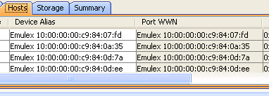
World Wide Name
Fiber channel equivalent of a MAC address
Every port has a WWN
WWNs can be aliased to make them readable

Slide 63
Port Zoning
Tells the fiber switch to allow communication from one port to another
Can be done by physical ports or WWNs (or aliases)
Physical port zoning makes replacing HBAs easier
WWN zoning makes moving HBAs to another port easier
Most array vendors do not support single zone, zoning

Slide 64
Port Zoning
In Windows 1 HBA is zoned to all array front end ports
In VMware 1 HBA is zoned to 1 front end ports
HBAs can be in multiple zones

Slide 65
Connecting Switches Together
Called ISL – Inter-Switch Link
Allows equipment on one switch to access other switch
Allows for network growth without replacing equipment
Brocade/McData requires ISL License
ISL Greatly reduces port counts
ISL cables only run at ½ speed
Multiple ISL ports should be on same ASIC
Always push config to switches, then activate.
Trunk ports for increased bandwidth

Slide 66
Basic ISL Diagram

Slide 67
ISL Diagram
Right Way
Wrong Way

Slide 68
Reduced Port Count

Slide 69
Calculating Network Latency
All latency is measured in one direction
1 meter = 5 nanoseconds of latency
100 meters = 1 microsecond
100 kilometers = 1 millisecond
1000 kilometers = 10 milliseconds
LA to NY = ~2778 miles = ~4470 km = 44 milliseconds
Add 2 microseconds for each ASIC change made
Keep those cables short!

Slide 70
Site to Site
FCIP – Fiber Channel over IP
FC Router – Fiber Channel Router (optional)
Allows switches to talk, without sharing a fabric
Zone from primary array to FCIP Router
Zone from secondary array to FCIP Router
Lots of bandwidth is required
Keep network latency in mind
Allows site to site array based replication

Slide 71
Site to Site Diagram

Slide 72
Monitoring
Switches require monitoring too
Depending on Switch MRTG may be able to be used
Some 3rd party tools exist

Slide 73
Virtualization Agenda
Major Platform Choices
Benefits
Pitfalls
Deciding Factors
Limits of Virtualization
Management Tools
Licensing

Slide 74
Major Platform Choices
VMware
ESX 1-3.5
vSphere 4.0 – 4.1
VMware announced 4.1 will be the last version with a host console 7/30/2010
vSphere Hypervisor (ESXi) 4.0+
Hyper-V
V1 and v2

Slide 75
Benefits
Hardware Costs
Instant Server Deployment
Free Server Redundancy
Live Migration – Hyper-V
vMotion - VMware
Easy System Upgrades

Slide 76
Pitfalls
Shared CPU
Shared Memory
Slow Disk Access times
Another layer of Management
Storage Path Flooding

Slide 77
Deciding Factors
Disk IO
IO Per Seconds
CPU Load
CPU Usage
Core Counts
Processor Queuing
Memory Usage

Slide 78
Virtualization Limits
vCPUs must be on the same physical socket
Changed as of vSphere 4.1, requires advanced guest configuration
vMotion or Instant Failover requires hosts have like CPUs models
Hyper-V doesn’t include memory de-duplication

Slide 79
Management Tools
VMware requires vCenter to manage a cluster
Hyper-V requires System Center Operations Manager
SCOM can also manage ESX 3.5 or vSphere 4.0 servers (requires vCenter server)

Slide 80
Thank You Sponsors!

Slide 81
Denny Cherry
mrdenny@mrdenny.com
http://itke.techtarget.com/sql-server
http://twitter.com/mrdenny
Please fill out the survey at http://speakerrate.com/mrdenny.
Twitter
Contact Info
Blog

